Slide 1
Integration of Neural Networks and Minimax Strategies in Chess Engine Development
BABEŞ-BOLYAI UNIVERSITY CLUJ-NAPOCA
FACULTY OF MATHEMATICS AND COMPUTER SCIENCE
SPECIALIZATION COMPUTER SCIENCE
Supervisor,
Asist. Univ. dr. Florentin Bota
Author,
Cadar Eduard

Slide 2
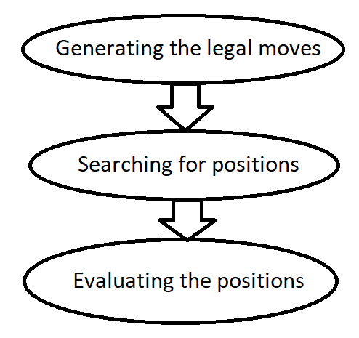
I. Introduction
Minimax
Optimizations: alpha-beta pruning, iterative deepening, quiescence search
Handcrafted function
Neural network

Slide 3
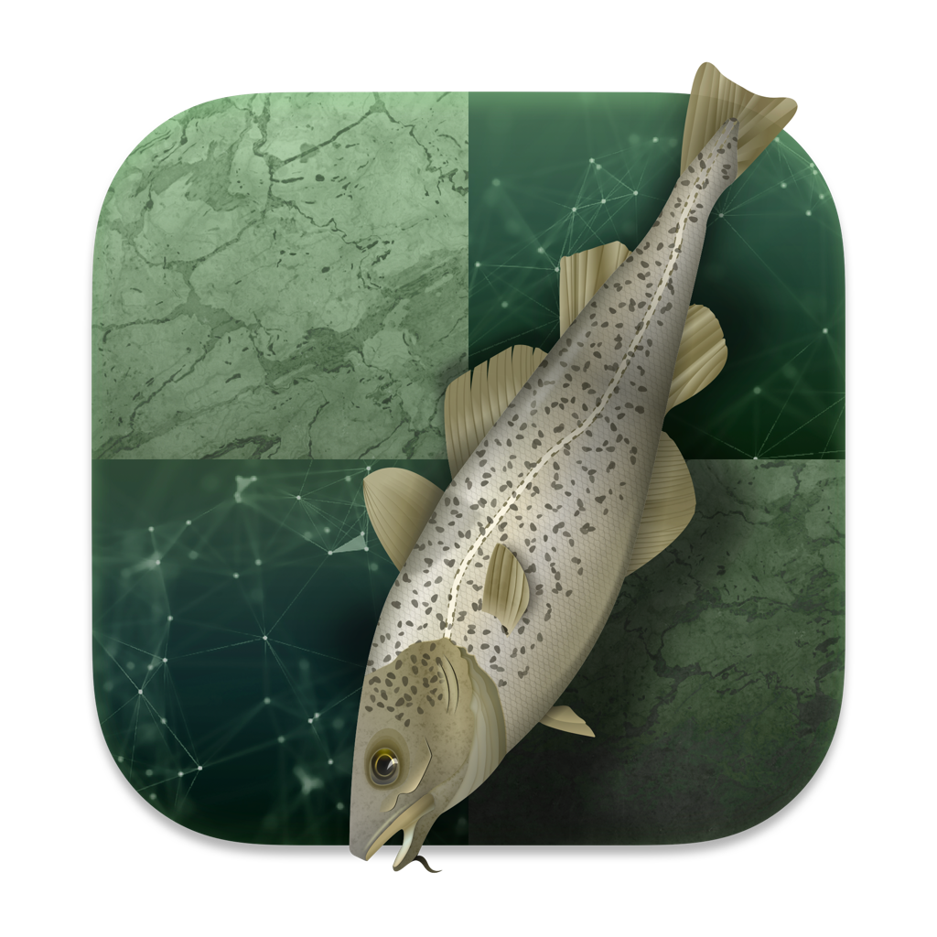

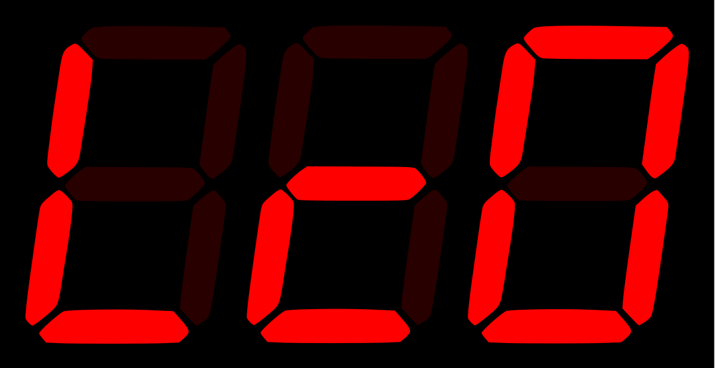
II. State of the art in chess engines
Stockfish – currently considered the strongest chess engine
AlphaZero – reached strong levels being given only the rules of the game, without game-specific human knowledge or data
LeelaChessZero – open-source community project based on the ideas of the AlphaZero paper

Slide 4
III. Algorithms and techniques
Search
Alpha-beta pruning
Iterative deepening
Quiescence search
Evaluation
Handcrafted function
Neural network evaluation

Slide 5
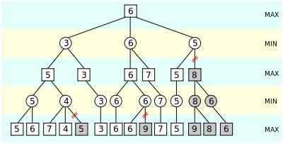
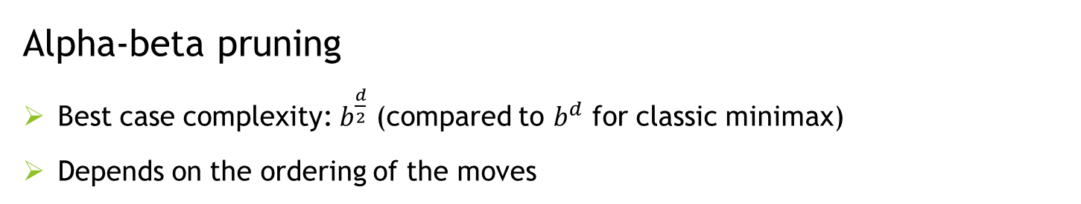
Search
Alpha-beta pruning
Best case complexity: $b^{\frac{d}{2}}$ (compared to $b^{d}$ for classic minimax)
Depends on the ordering of the moves

Slide 6
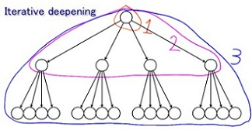
Search
Iterative deepening
Re-does the search for each fixed depth until a time limit is reached

Slide 7
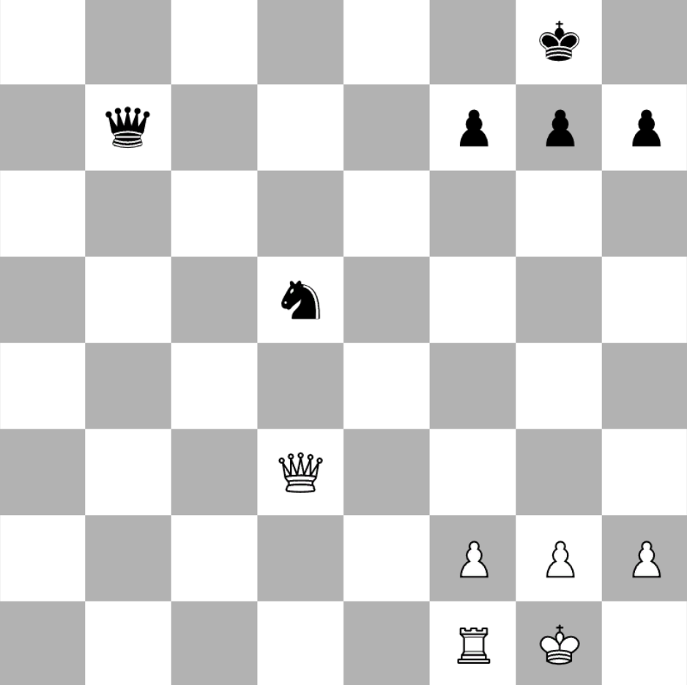
Search
Quiescence search
Continues the search in non-quiescent positions

Slide 8
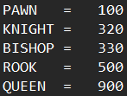
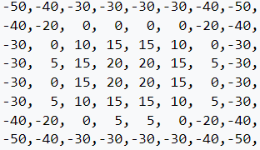
Evaluation
Handcrafted function
Each piece has a base value
Each piece is given bonus/penalty points for being on certain squares

Slide 9
Evaluation
Neural network
Trained on grandmaster chess games
Outputs a value between -1 (winning for black) and 1 (winning for white)

Slide 10
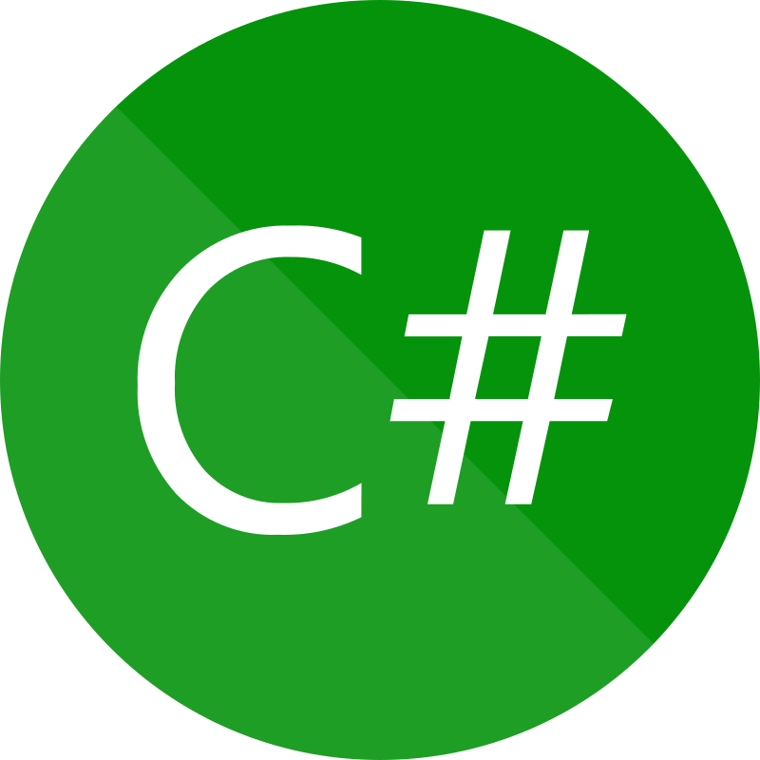

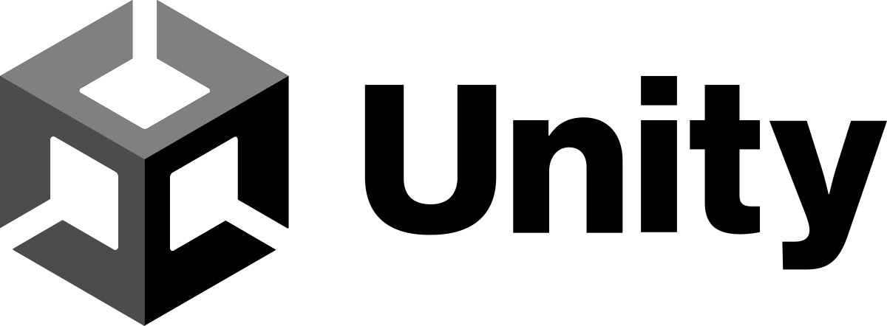
IV. Technologies
Chess engine – C#, Keras
Chess game interface - Unity

Slide 11
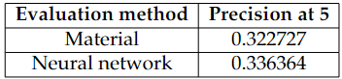
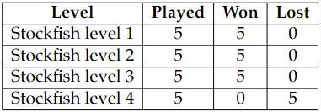
V. Results and evaluation
Precision at K metric
Matches against Stockfish

Slide 12
VI. Further work
Faster move generation (using bitboards)
Improve neural network model
Implement UCI (Universal Chess Interface) protocol

Slide 13
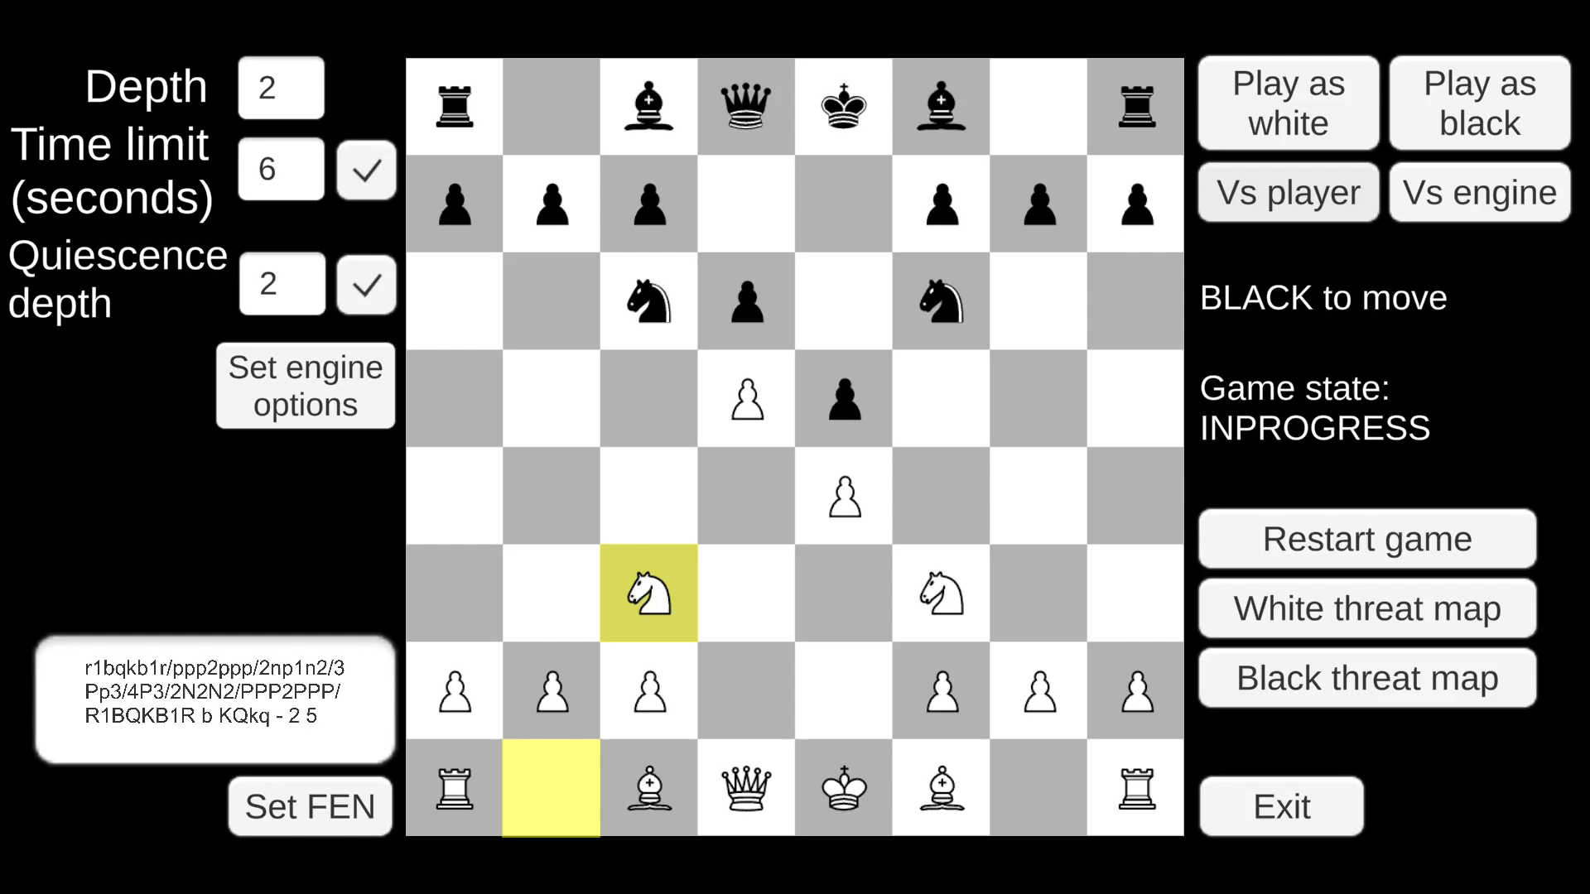
Demo

